Slide 1
Curse of Dimensionality and Overfitting
Source: SAS Training

Slide 2
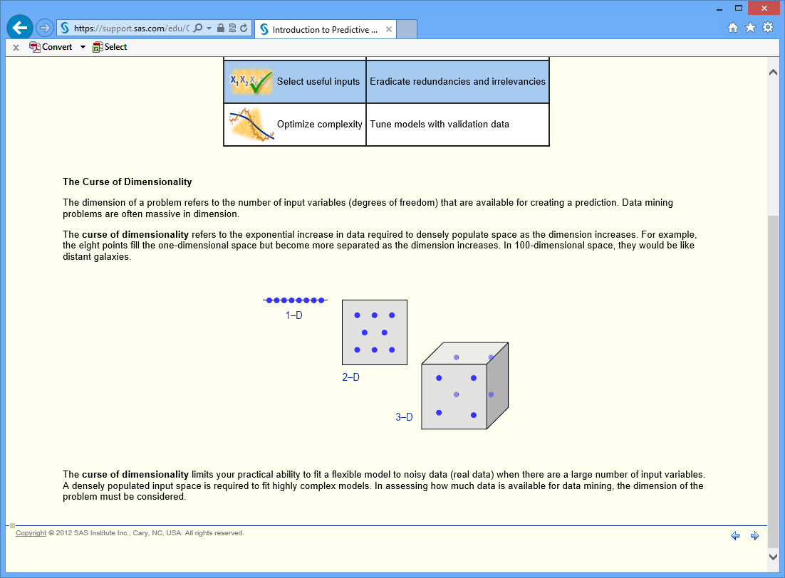

Slide 3
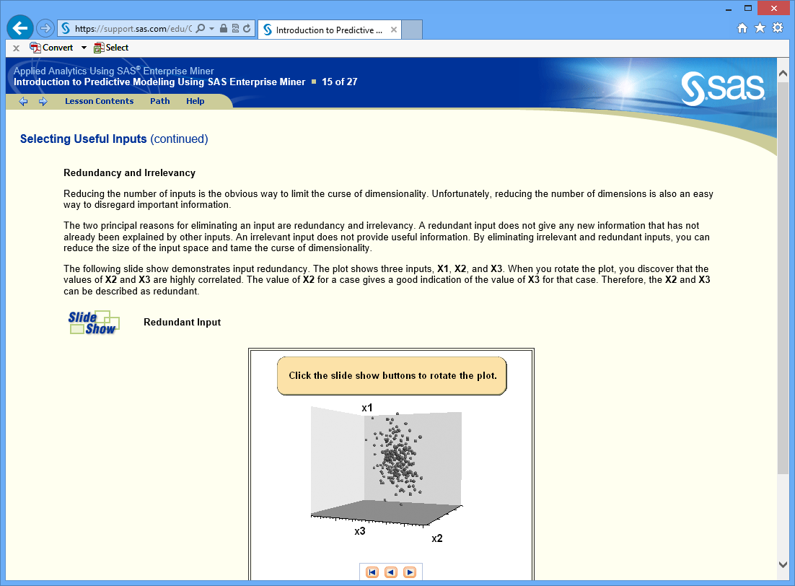

Slide 4
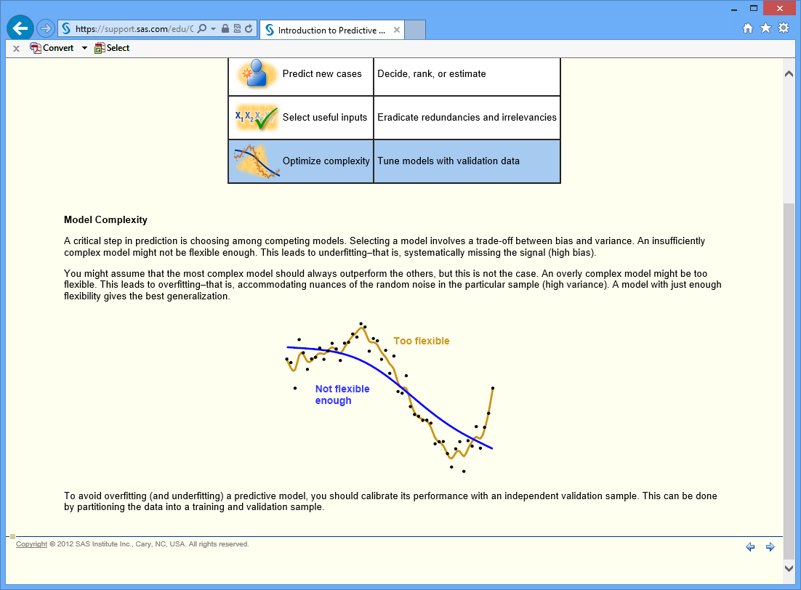

Slide 5
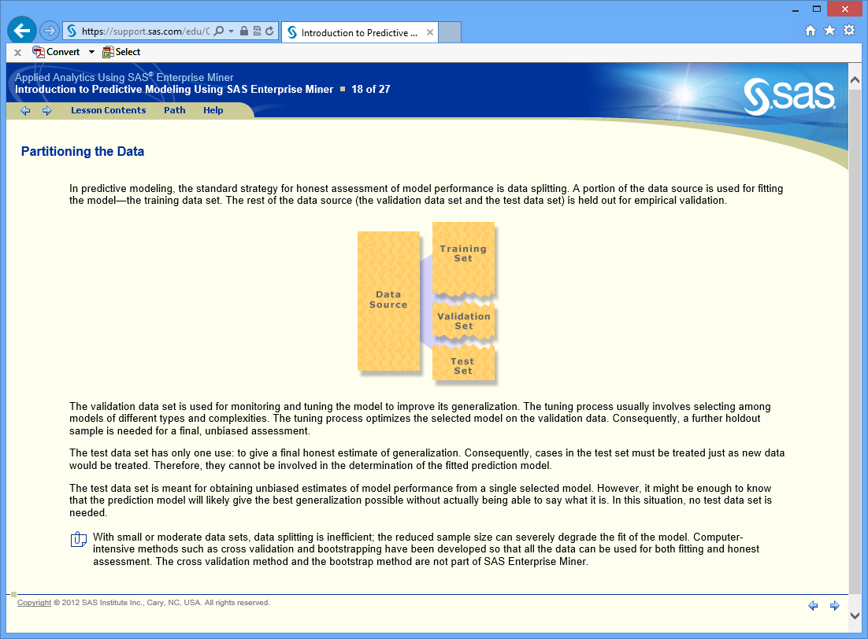

Slide 6
